Slide 1
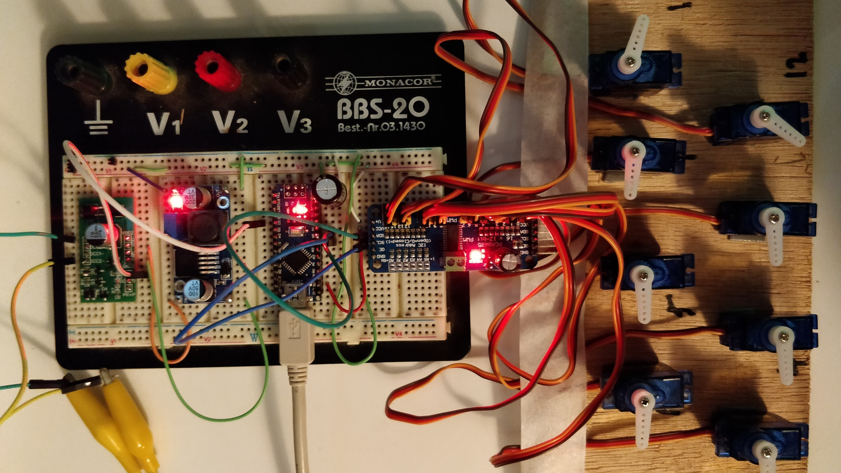
DIY DCC
16 Channel
Servo Decoder
Part 2

Slide 2
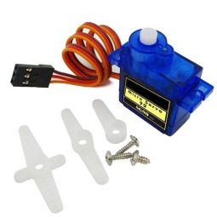
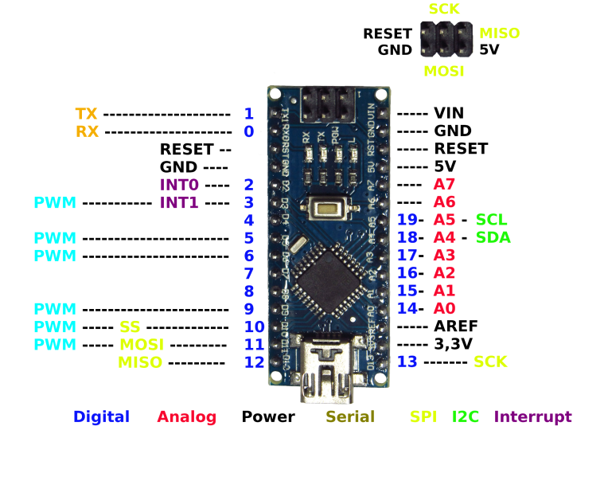
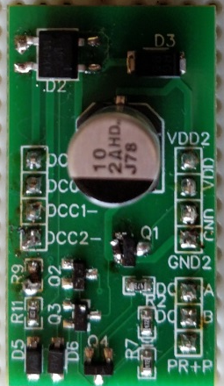
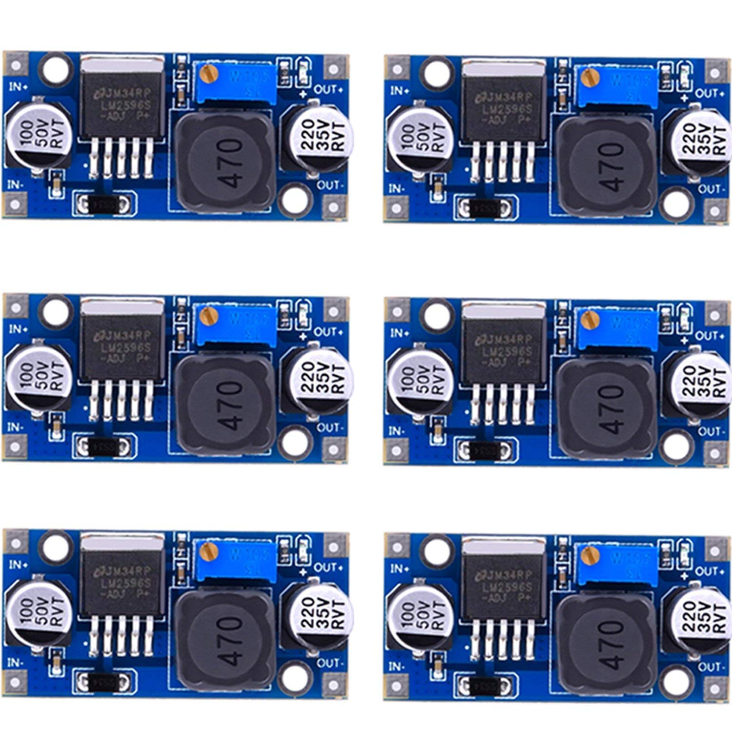
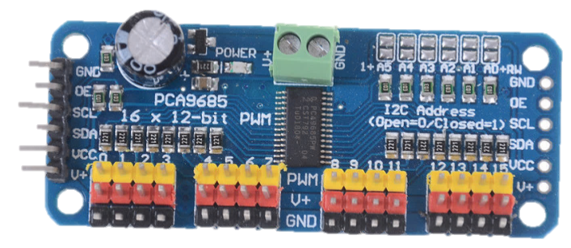
Arduino Nano Accessory Decoder
5V
Set to 7.5V
Connect up to
16 Servos SG90
3.5 - 8.4 Volts
DCC Track
DCC Interface
Buck Converter
Arduino Nano
PWM Driver

Slide 4
Servo Decoder Requirements
Connects to DCC, no additional power supply
Individual Address for each Servo
Support of full Switch and Signal Address Ranges
Adjustable Rotation Angles per Servo
Adjustable Rotation Speed per Servo
✓
×
×
×
×

Slide 5
Software Development Steps
Verify that DCC Signal is decoded
Verify that Servos can be controlled
Build the bridge between DCC and Servos
Improve and add more features
✓
✓
✓
×

Slide 6
Building the Bridge
The initial approach
Works, but…
All Servos in a linear address range starting with first address
Signal commands not handled at all
All Servos with the same minimum and maximum rotation angles
Decode DCC Input
Set Servo port PWM Output

Slide 7
Building the Bridge
First improvement
Decode DCC Input
Look up port based on address
Look up specific rotation angle
Set Servo port PWM Output

Slide 8
Building the Bridge
First improvement
Better, but…
Servos will always move using their maximum speed
Decode DCC Input
Look up port based on address
Look up specific rotation angle
Set Servo port PWM Output

Slide 9
Building the Bridge
Second Improvement
Phase 1:
Decode DCC Input
Look up port based on address
Look up specific rotation angle
Set Servo port PWM Output
Phase 2:
Compare Target and Current Value
Incremental Advance
Apply Timeout for Speed Control

Slide 10
Building the Bridge
Second Improvement
Complete Speed Control
Short Event Handling time
Concurrent movement of several servos
Phase 1:
Decode DCC Input
Look up port based on address
Look up specific rotation angle
Set Servo port PWM Output
Phase 2:
Compare Target and Current Value
Incremental Advance
Apply Timeout for Speed Control

Slide 11
Summary
Today it is possible to buy standard components for solving the most common electronic problems. All we need to do is connecting them with a few wires
On the software side, there are hundreds of open source libraries available. If you can find a component for your problem, than you will also find a library that supports it
We can focus on the application software. As little as 100 lines of Arduino code can do the trick
There is no reason why we should not build our control devices ourselves. The possibilities are endless

Slide 12
Table of Contents
Review Part 1 0:58
Improvements
Step 1: Adding signals, individual addresses and rotation angles 2:03
Step 2: Adding individual rotation speed 22:22
Summary 36:49

Slide 13
Additional Materials on Github: https://github.com/tanner87661/IoTT-Video18
Arduino Basics 101: https://www.youtube.com/watch?v=BtLwoNJ6klE
Arduino Basics 102: https://www.youtube.com/watch?v=YT3birSKLLU&t=398s
Arduino Basics 103: https://www.youtube.com/watch?v=EVm0qVJ56II
Arduino State Management: https://www.youtube.com/watch?v=3VZgaJBrZD8
Layout Intro Sequence Outdoor Layout: Beat Deola, Switzerland​
DCC Interface: If interested, send me a PM. I have some of the prototypes available for cost plus shipping.
Buck converter: https://www.amazon.com/MCIGICM-step-down-Converter-3-0-40V-1-5-35V/dp/B06XZ1DKF2/ref=sr_1_5?keywords=buck+converter&qid=1554521368&s=gateway&sr=8-5
Arduino Nano: https://www.amazon.com/Keywish-Arduino-ATmega328P-Moudle-Compatible/dp/B07D12TWNZ/ref=sr_1_18?keywords=arduino+nano&qid=1554521411&s=gateway&sr=8-18
PWM driver: https://www.amazon.com/Onyehn-Channel-PCA9685-Arduino-Raspberry/dp/B07GJCPWW2/ref=pd_day0_hl_147_2/144-9269444-7135168?_encoding=UTF8&pd_rd_i=B07GJCPWW2&pd_rd_r=7c0128c8-581c-11e9-8362-b1c2d0dccc11&pd_rd_w=ebl7B&pd_rd_wg=XDjih&pf_rd_p=ad07871c-e646-4161-82c7-5ed0d4c85b07&pf_rd_r=MFZXEC12T0FFV415AHQ4&psc=1&refRID=MFZXEC12T0FFV415AHQ4
Micro Servos: https://www.amazon.com/Micro-Helicopter-Airplane-Remote-Control/dp/B072V529YD/ref=pd_bxgy_60_img_2/144-9269444-7135168?_encoding=UTF8&pd_rd_i=B072V529YD&pd_rd_r=86eda38f-581c-11e9-9502-091092cc734e&pd_rd_w=OfHyY&pd_rd_wg=VPeRR&pf_rd_p=a2006322-0bc0-4db9-a08e-d168c18ce6f0&pf_rd_r=PTY6VGCE68SEB9VVHH2E&psc=1&refRID=PTY6VGCE68SEB9VVHH2E
16 channel Relay Driver Board: https://www.iascaled.com/store/I2C-RELAY16
8 channel I2C Relay board: https://www.tindie.com/products/jap/8-channel-relay-board-for-raspberry-pi-and-arduino/

